Slide 1
Online Micro Center
Purbasha Pan – 002653065

Slide 2
Overview
In this Project, we have implemented following Design Patterns
Builder
Decorator
Façade
Adapter
Factory
Command
Observer
Prototype
State
Strategy

Slide 3
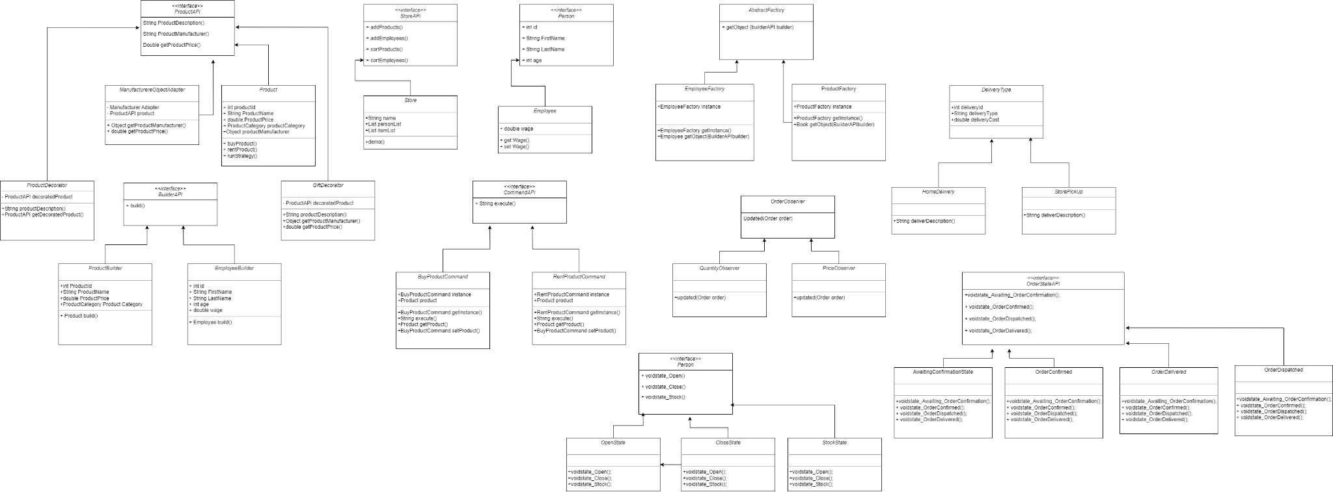

Slide 4
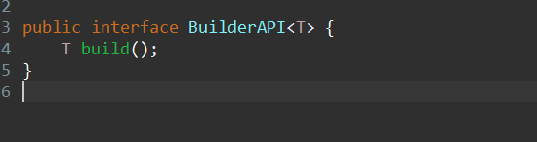
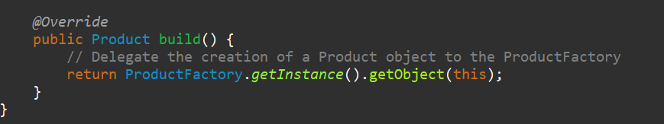
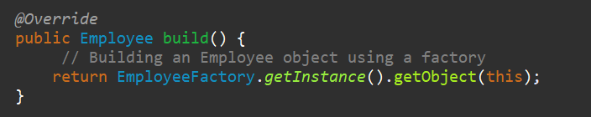
Builder
Introduced the Generic Builder interface, termed as `BuilderAPI`, which encompasses a key method:
`T build()`
Two distinct classes, namely `EmployeeBuilder` and `ProductBuilder`, are derived from the `BuilderAPI`. These classes actively engage with their corresponding factories, effectively producing instances of the pertinent classes. This is achieved through the invocation of the respective factories during the building process.

Slide 5
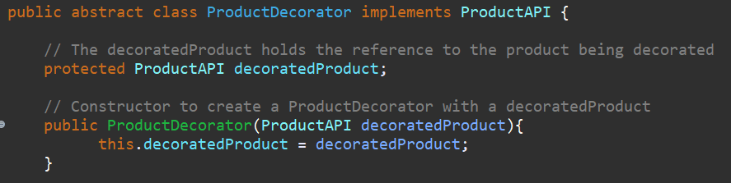
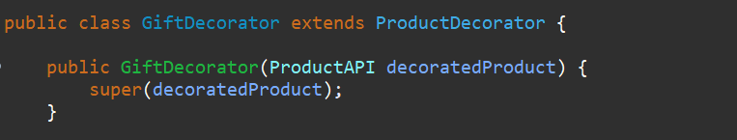
Decorator
Designed an abstract class named `ProductDecorator`, which stands as an implementation of the `ProductAPI`. The primary objective of this design pattern is to envelop an existing object.
To enhance the capabilities of an existing `Product` object, I've introduced a subclass termed `GiftDecorator`. This particular class extends the `ProductDecorator`, serving as a means to append supplementary functionality to the preexisting `Product` object.

Slide 6
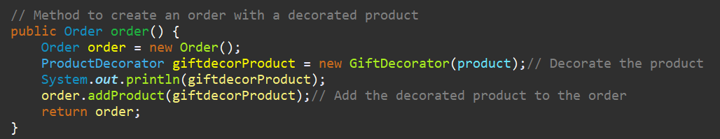
Façade Pattern
An `OrderFacade` class is designed that operates by accepting a `Product` object through the concept of object composition.
Within this class, there exists a method named `order()`, which is responsible for instigating the creation of a fresh `Order` object. During this process, the `Product` object is adorned with additional features, essentially decorating it, before being incorporated into the newly formed `Order`.

Slide 7
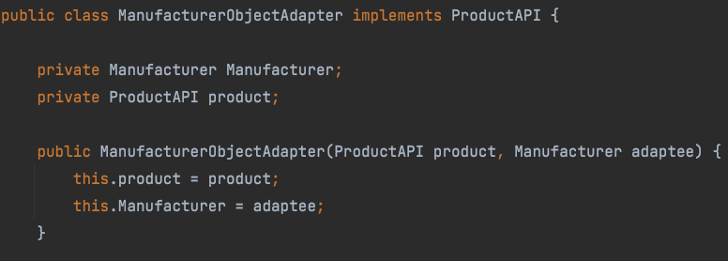
Adapter
Designed`ManufacturerObjectAdapter` that implements the `ProductAPI` interface and encapsulates both the `Manufacturer` and `Product` objects.
The objective of this class is to establish a harmonious collaboration between the `Manufacturer` class, which implements `Cloneable`, and the `Product` class.
The `ManufacturerObjectAdapter` facilitates communication and interaction between these two classes, enabling seamless cooperation and synchronization of functionality.

Slide 8

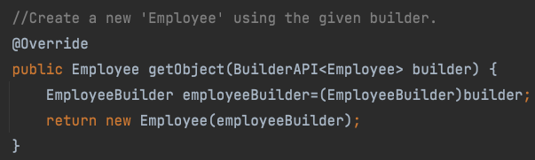
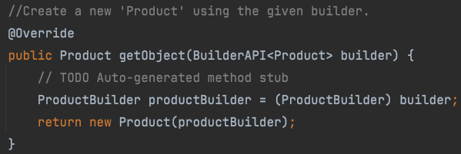
Factory / Singleton
Designed an `AbstractFactory` interface that encompasses a method called `getObject()`. Within this interface, established a blueprint for the creation of objects.
Furthermore designed two subclasses, namely `ProductFactory` and `EmployeeFactory`, both of which adhere to the `AbstractFactory` interface. These subclasses are responsible for implementing the `getObject()` method, which leverages builder objects from their corresponding classes to generate objects of specific data types.

Slide 9
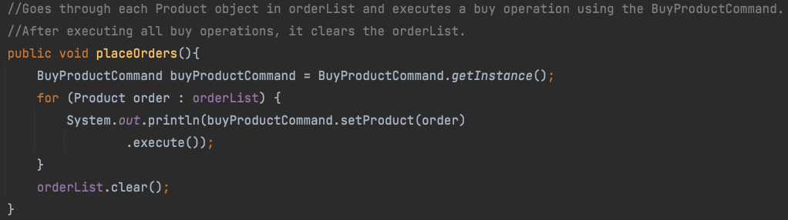
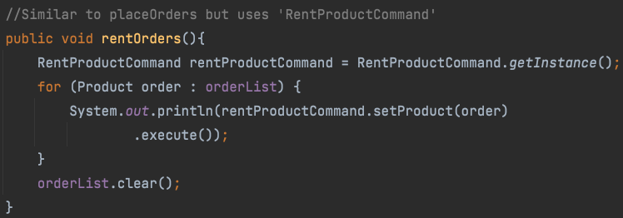
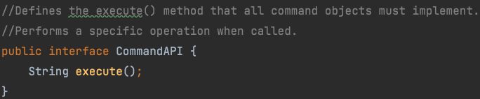
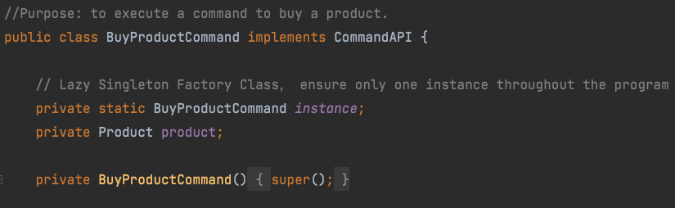
Command
Designed an interface named `CommandAPI`, encompassing a method named `execute()`. This design pattern's core intention revolves around transmitting the directive to either "purchase" or "rent" a product.
To facilitate this pattern, we established two classes, namely `BuyProductCommand` and `RentProductCommand`, both of which extend the `CommandAPI`. These classes act as specialized entities that encapsulate the instructions for buying and renting products.
Moreover, an `Invoker` class has been formulated to activate particular objects that execute the commands imparted by the receiver, thereby orchestrating the process of product acquisition or rental.

Slide 10
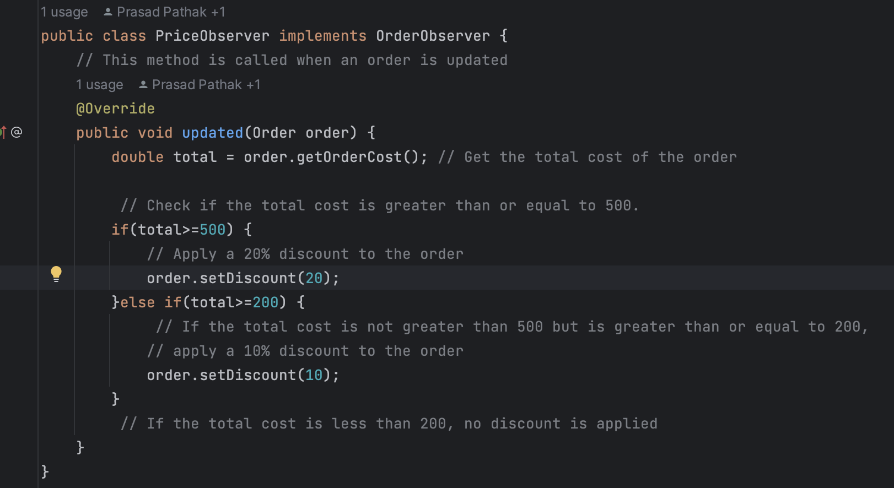
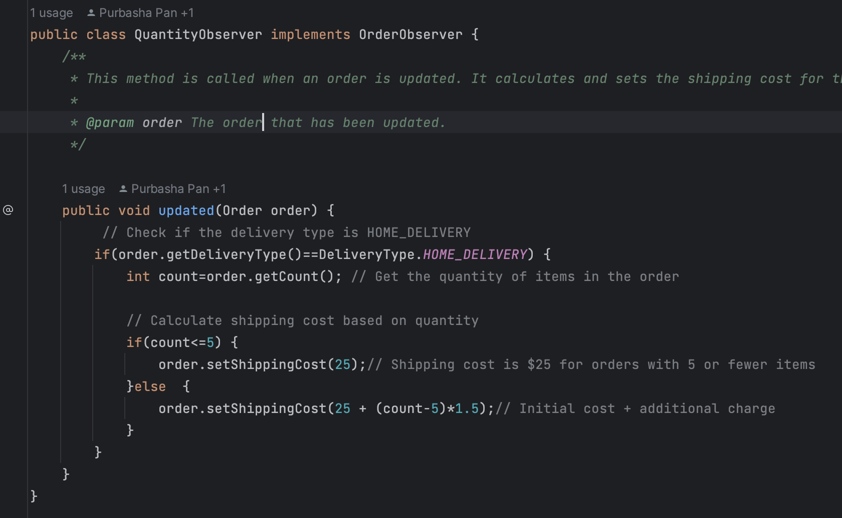
Observer
Designed an `OrderObserver` interface encompassing the method `updated()`. This method accepts an `Order` object as an argument.
Deriving from this interface, two distinct classes named `PriceObserver` and `QuantityObserver` have been created. Both these classes implement the `OrderObserver` interface.
The `PriceObserver` class is responsible for determining the appropriate discount based on the overall amount of the order.
On the other hand, the `QuantityObserver` class takes on the task of calculating the delivery cost, which is contingent upon the quantity of items present in the order.

Slide 11
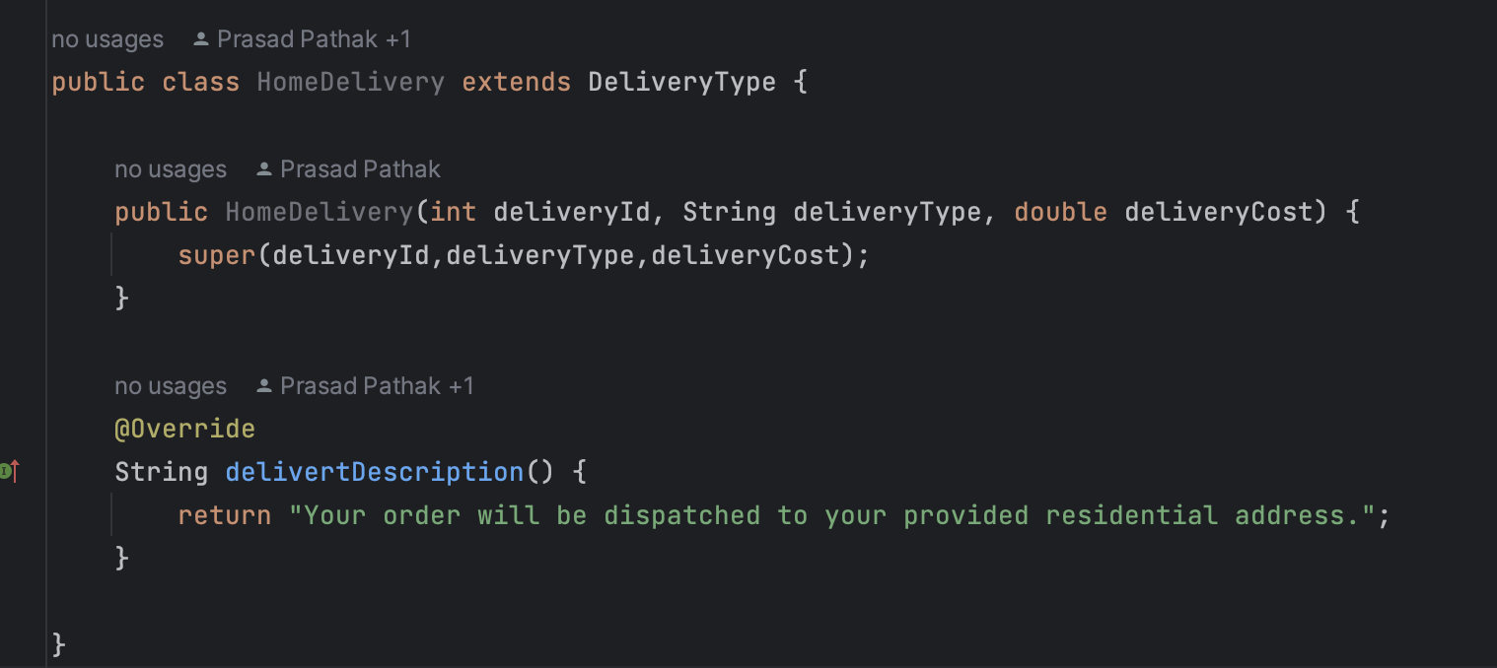
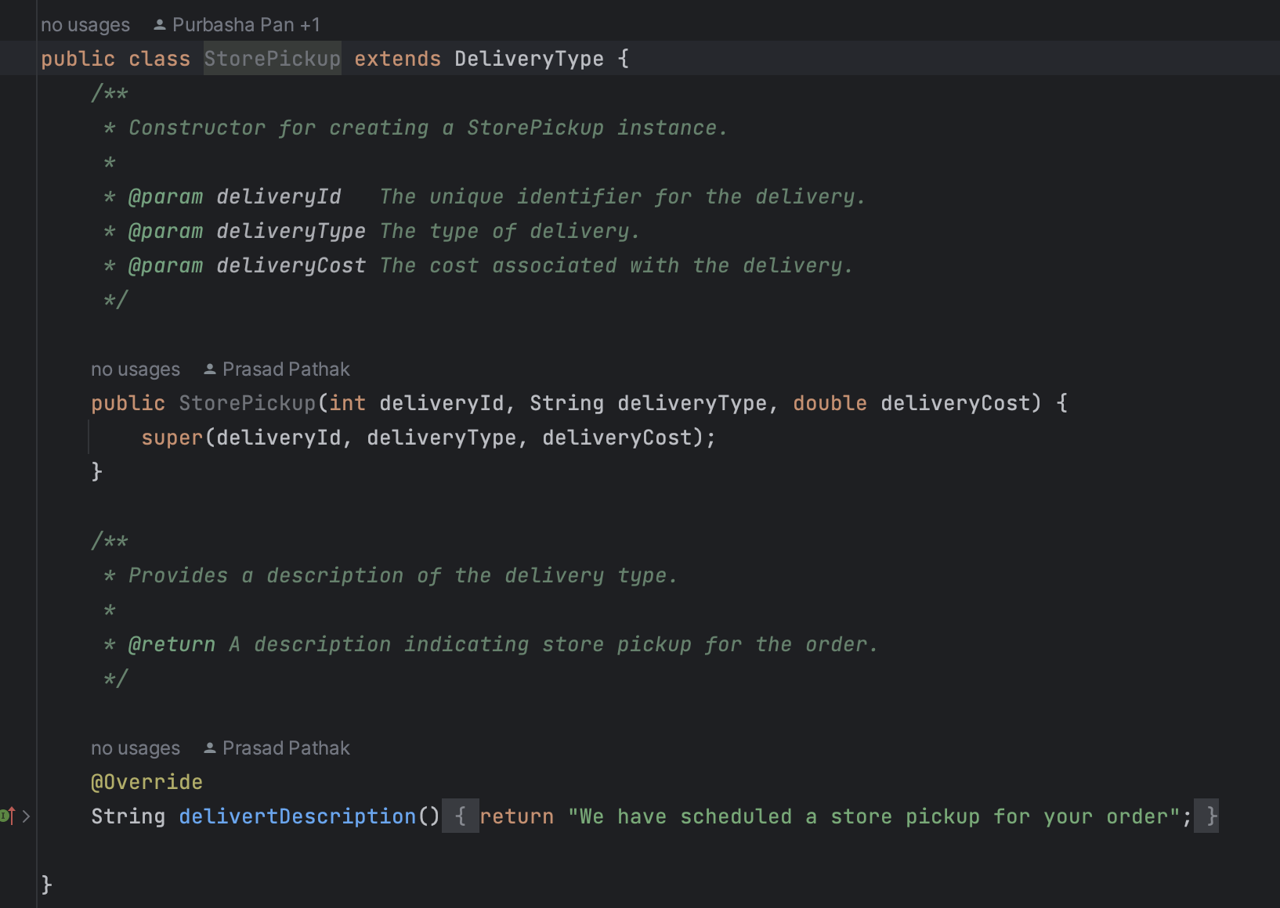
Prototype
Designed a Delivery Service module to showcase the application of the Prototype Pattern.
As a part of this design, created an abstract class called `DeliveryType`. This class implements the `Cloneable` interface and encompasses the subsequent attributes:
- `deliveryType`
- `deliveryId`
- `deliveryCost`
To further refine this structure, I've derived two distinct classes, namely `HomeDelivery` and `StorePickUp`, both of which extend the `DeliveryType` class. Additionally, these subclasses override the `deliveryDescription()` method, allowing for specialized descriptions to be implemented.
This approach leverages the Prototype Pattern to create a versatile and extensible framework for managing various delivery types within the Delivery Service

Slide 12
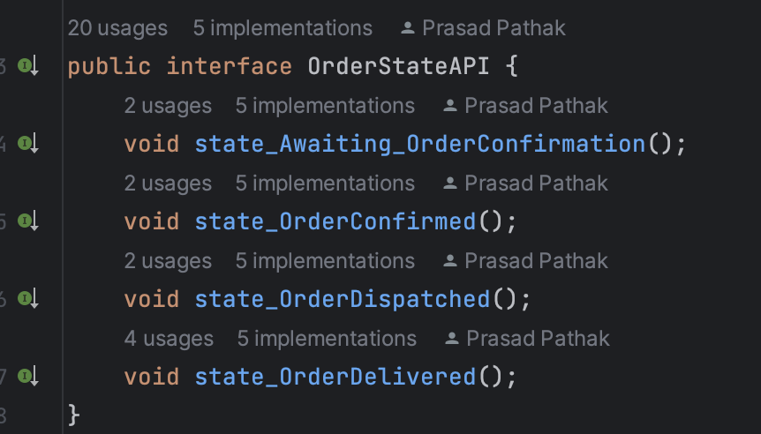
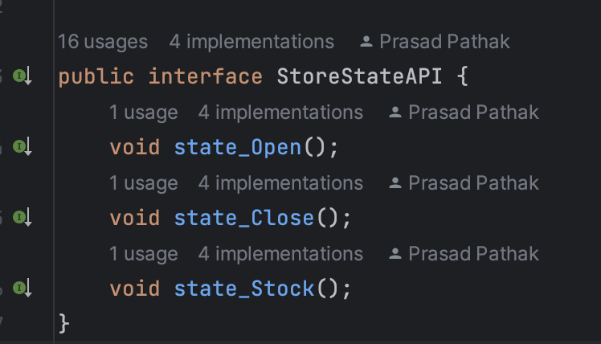
State
Created two interfaces: `ProductStoreStateAPI` and `OrderStateAPI`.
We then derive three classes from `ProductStoreStateAPI`, each of which implements the methods:
`state_Open()`,
`state_Close()`,
`state_Stock()`.
Additionally, designed four classes derived from `OrderStateAPI`, with each of these classes implementing the methods:
`state_Awaiting_OrderConfirmation()`,
`state_OrderConfirmed()`,
`state_OrderDispatched()`,
`state_OrderDelivered()`.
For the implementation side, the `ProductStore` class has been designed to adhere to the `ProductStoreStateAPI`, while the `Order` class follows the `OrderStateAPI`. This design structure helps in organizing and managing the various states and behaviors associated with both product stores and orders.

Slide 13
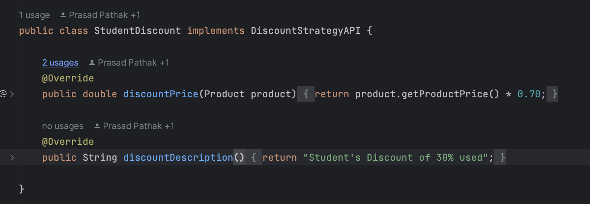
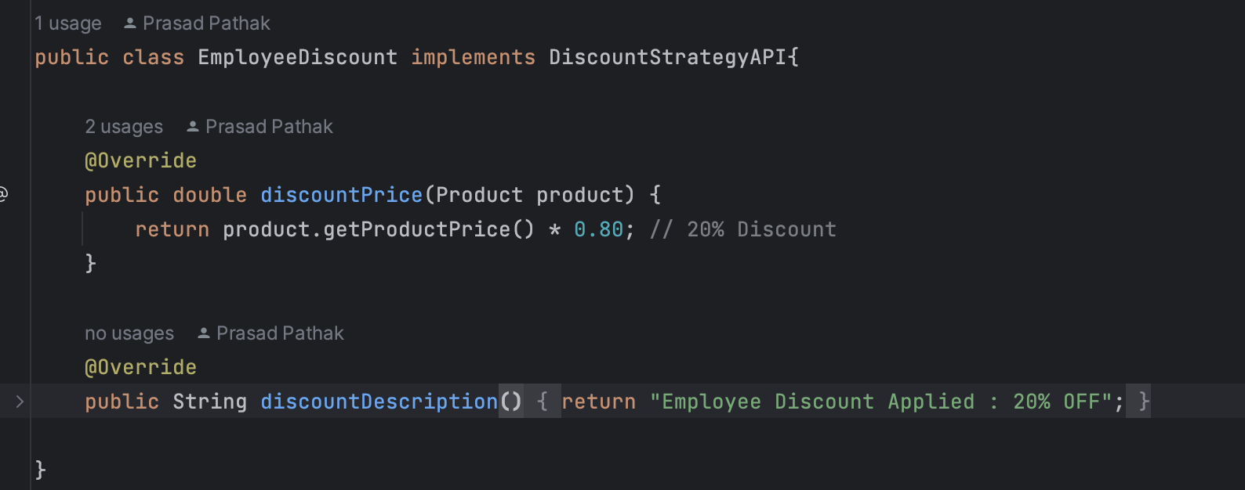
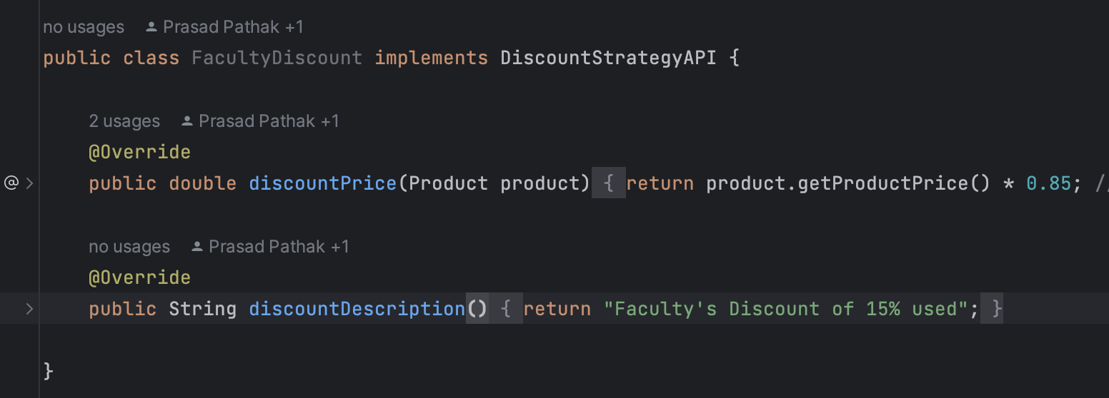
Strategy
Created an interface called `DiscountStrategyAPI` encompassing the subsequent methods:
- `discountedPrice()`
- `discountedDescription()`
Three distinct classes, namely `EmployeeDiscount`, `FacultyDiscount`, and `StudentDiscount`, have been derived from the `DiscountStrategyAPI`. These classes effectively implement the discount strategies, each tailored to its respective category, thereby adhering to the principles outlined in the interface.

Slide 14
Future enhancements
Integrating Payment options
Integrating responsive User Interface
Implementing User Authentication and account management
Designing a rating and review system
Implementing recommendation engine

Slide 15
Thank you

